Slide 1
IN THE NAME OF GOD
KIMIA KIANI

Slide 2
Source of history:mother
G2p2
no developmental and growth delay
Irani and low socioeconomic

Slide 3
The patient is 3 y old boy with no significant familial and past medical history
presenting with abdominal pain and interactable vomiting for several days ago
Treatment for viral infection
Attempting to out patient clinic and prescribing with acetaminophen,dicyclomine,osempprazol, and dimitrone
From the first time in morning of the admission day in ER he starts having nausea and vomiting with the previous abd pain and loss of appetite and due to poor feeding and low grade fever attemps to pediatric ER

Slide 4
At the time of the patients entrance
Low grade fever{38}
Nausia +vomiting+hypogastric abd pain
Mass detection in right inguinal space although no testicles at right side sac +hypogastric pain and little tenderness
Inguinal ultrasonography{completely normal and no sign of incarceration}

Slide 5
Rehydration and anti pyretics prescribed
After some times no fever no vomiting and hydrated with about 750 cc normal salin
Abdominal pain felt cramp like pain in hypogastric and then shift to RLQ low appetite,fever
physical examination: vitals were normal , RLQ tenderness ,shifting pain rebound,
Orderd surgical consult for appendicitis(PAS:8)

Slide 6
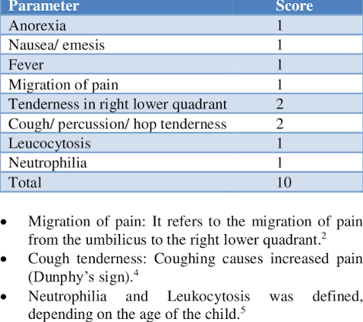

Slide 7
WBC:13700( N:84% L:11% M:3% E:2% )
HB:12.5 HCT:35 PLT:396
UREA:31 CR:0.47 NA:145 K:4.1 CRP:1
Wbc in urine(taken sterile with nelatone):many

Slide 8
Surgical consult
Sono:no target lesion
Reactive lynph node in border of mesenteric area
The surgeon came to visit patient in ped ward and noted
Due to negative sono report and little tenderness
Ultrasonography of attendings tomorrow morning

Slide 9
Impresion :acute appendicitis
Serum:d.s maintenance +ab therapy+npo+panto

Slide 10
The patients was feverish around 5 am in the next day and apotel prescribed
The patient starts with vomiting and coffee ground discharge) at 7 and complained)and had no urine output
The pediatritionist note:very dehydrated,sunken eye,dry mucus, hands were warm and distal pulses was bilateral and firmly detected PR:110-120
Drowziness distended abdomemen with generalized tenderness and gaurded
She prescribed pantoprazole and P.C reservation,picu care,emeregent surgical visit and labs And broad spectrum antibiotics

Slide 11
The surgeon
Fully inserted no urine outcome and increased inflammation of inguinal area
No gaurding but generalized tenderness
Attending sono:over size dilatation and fullness of bladder and sign of bilateral severe hydronefrosis,there is no head of folley detected
Suggested:patient is in uremic phase and bowles low movement and obstruction is due to hydronephrosis and bladder pressure
Folley was taken off but significant light hematuria detected

Slide 12
UROLOGIST:
warming
No catheter insertion
Suprapubic cathetrization as soon as possible
Late cystoscopy
After empting the bladder the patient belly was soft no sign of acute abdomen and the patient was re admitted to picu

Slide 13
Several hours later:
Nausea vomiting and abdominal pain started again in physical exam the abdomen was tender and guard
TR rectum was empty
AXR =some air fluid level but no air under diaphragm
NGT FIXED and bilous excretion detected we wanted surgical consult but the patients father discharged and take him to yazd

Slide 14
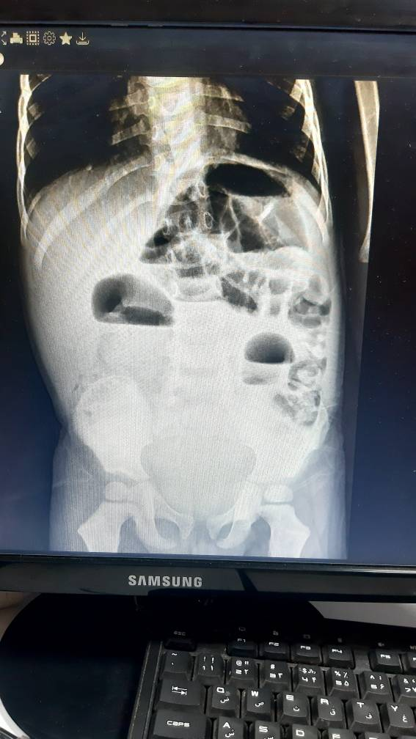

Slide 15
Pediatrics surgery in yazd informed the patient was emeregently moved to OR and laparotomy was don near perforated bowel in site of me meckel
and meckle diverticulum was removed from the patient
Suprapubic was there
The patient discharged 3 days after surgery and was completely ok

Slide 16
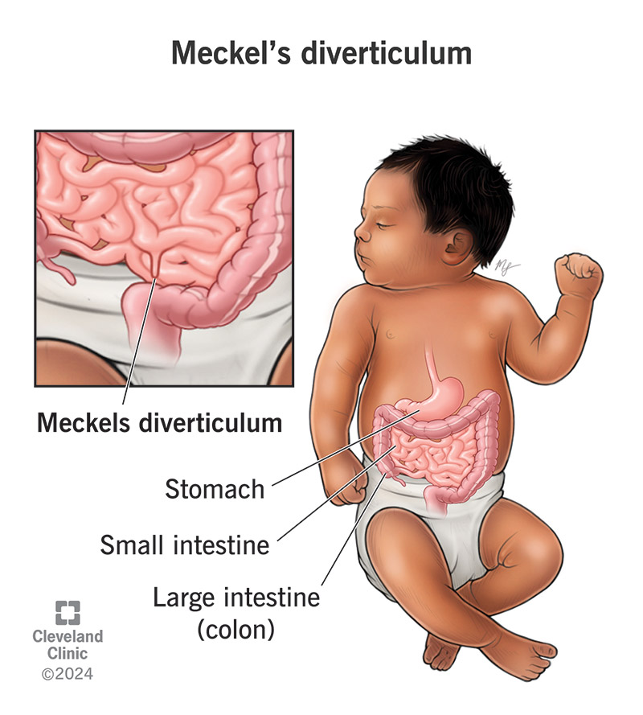
MECKEL DIVERTICULUM
a true congenital pouch (bulge) in the lower small intestine caused by the incomplete closure of the vitelline (omphalomesenteric) duct during fetal development.

Slide 17
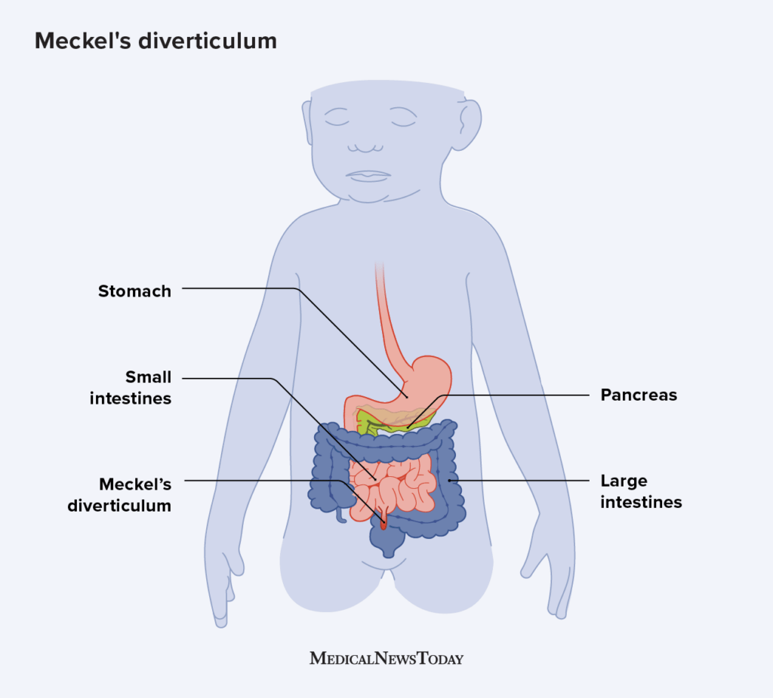

Slide 18
While a human fetus is developing, the vitelline duct connects the intestines to the umbilical cord. When this duct does not properly close, the small intestine walls create a pouch or a condition called Meckel’s diverticulum.

Slide 19
The symptoms of Meckel’s diverticulum vary, but gastrointestinal (GI) bleeding is one of the most symptoms.
nausea
abdominal pain
vomiting

Slide 20
The majority of people with a Meckel's diverticulum are asymptomatic. The most common presenting symptom is painless rectal bleeding such as melaena-like black offensive stools, followed by intestinal obstruction, volvulus and intussusception. Occasionally, Meckel's diverticulitis may present with all the features of acute appendicitis

Slide 21
The diagnosis of bleeding Meckel’s diverticulum can be challenging.
A technetium-99m pertechnetate scan (Meckel’s scan) is the standard noninvasive diagnostic method for children with lower gastrointestinal bleeding

Slide 22
Children with Meckel’s diverticulum need surgery to correct their condition if symptoms are present. In many cases, this involves surgical correction.
Surgical treatment also involves the removal of the diverticula. Most children who undergo this surgery recover fully and do not experience serious complications.

Slide 23
Meckel's diverticulum can occasionally cause urinary retention, though this is a very rare presentation. When it happens, urinary symptoms usually stem from local inflammation, perforation, or structural involvement near the lower urinar

Slide 24
ABDOMINAL PAIN APPROACH IN CHILDREN

Slide 25
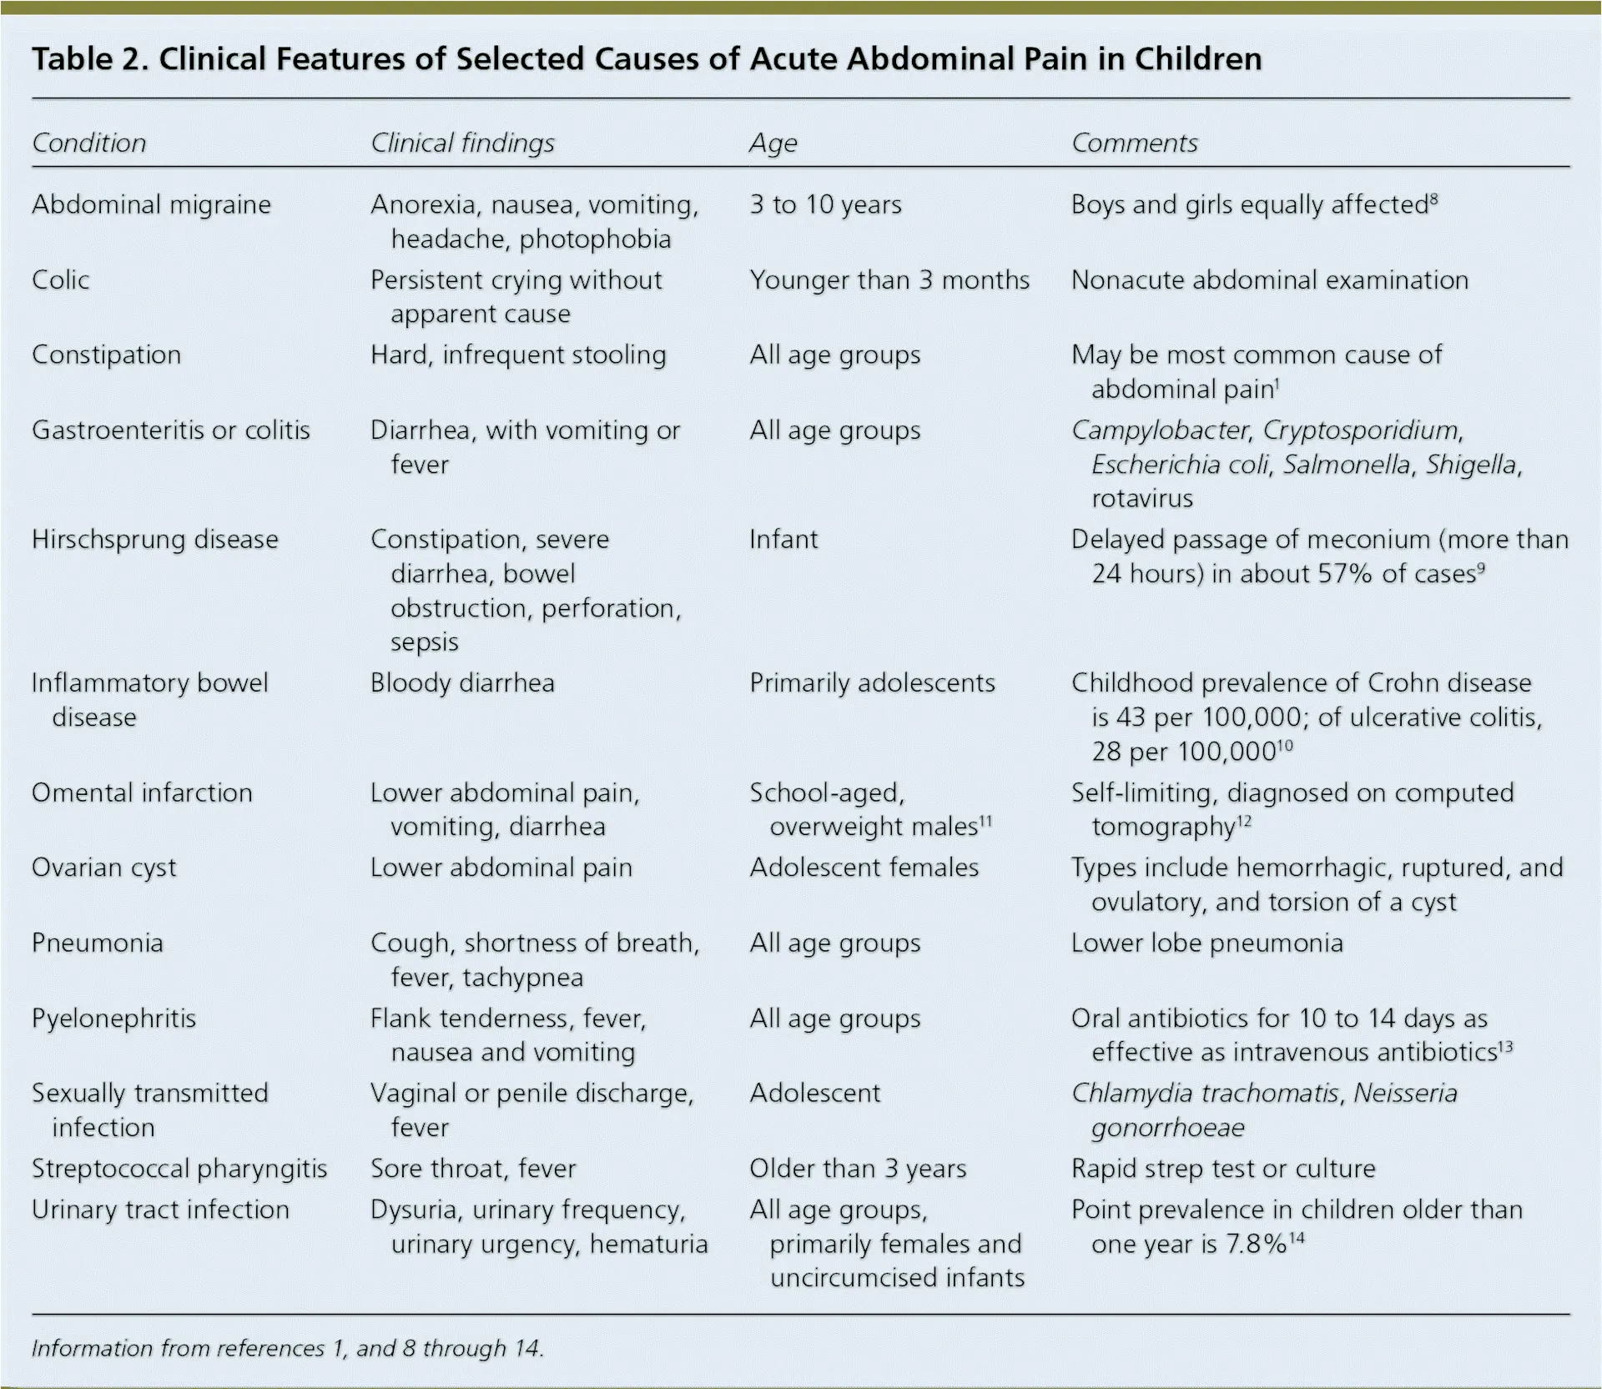

Slide 26
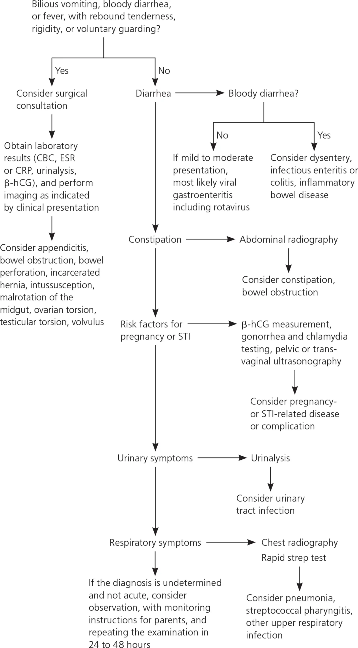

Slide 27
PEDIATRICS URINARY CATHETERISATION

Slide 28
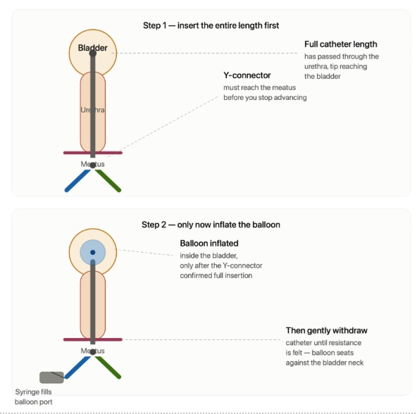

Slide 29
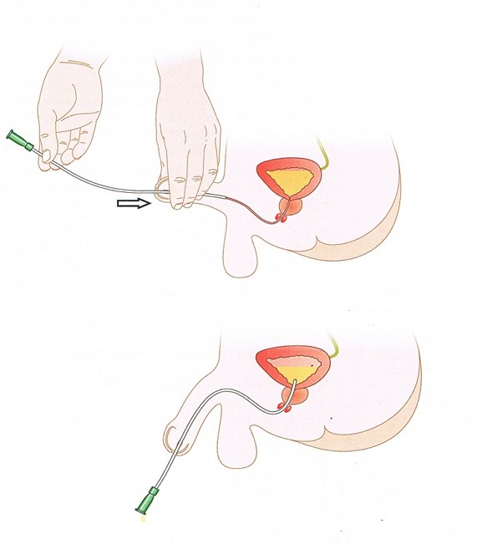

Slide 30
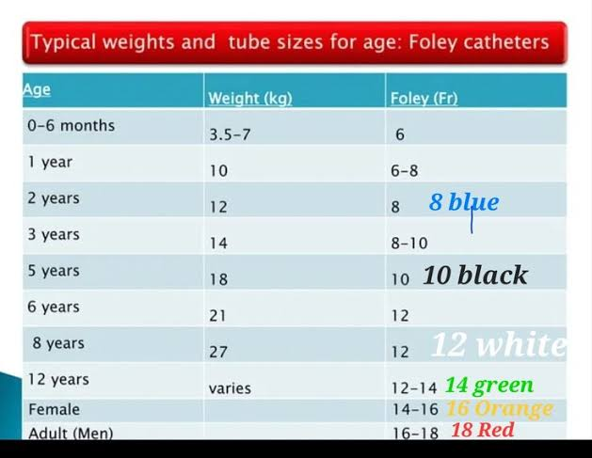

Slide 31
Step 1: Patient Preparation
Explain procedure to patient and family using age-appropriate language. Position patient appropriately. Ensure privacy and comfort

Slide 32
Step 2: Catheter Selection
Select appropriate catheter size based on patient age and gender. Prepare catheter with lubricant. Check balloon integrity.

Slide 33
Step 3: Genital Cleaning
Clean genital area with antiseptic solution. Use sterile technique. Maintain sterility throughout procedure
Step 4: Catheter Insertion
Insert catheter gently into urethra. Advance until urine flows. Inflate balloon if using Foley catheter

Slide 34
Step 5: Placement Confirmation
Confirm proper placement with urine flow, balloon inflation, and patient comfort. Secure catheter appropriately.
Step 6: Post-Insertion Care
Connect to collection bag. Secure catheter. Document procedure details. Monitor for complications

